Slide 1
FYP Proposal Presentation
Exam Seating Management System (ESMS)
Developed by: Aqeel Khan Supervised by: Dr. Kashif Rizwan Coordinator: Mr. Khawaja Tahir Mehmood Department of Computer Science – FUUAST, Islamabad

Slide 2
Introduction
The current exam seating process in universities is mostly manual.
Leads to errors: duplicate seat numbers, overlapping schedules, and confusion.
Our system automates this entire process.
Ensures accuracy, transparency, and time efficiency.

Slide 3
Problem Statement
Manual seat allocation causes:
Overlapping exam schedules
Duplicate seat assignments
Human errors and inefficiency
Difficulty managing hall capacities
Need for an automated web-based system to handle seating arrangements smartly.

Slide 4
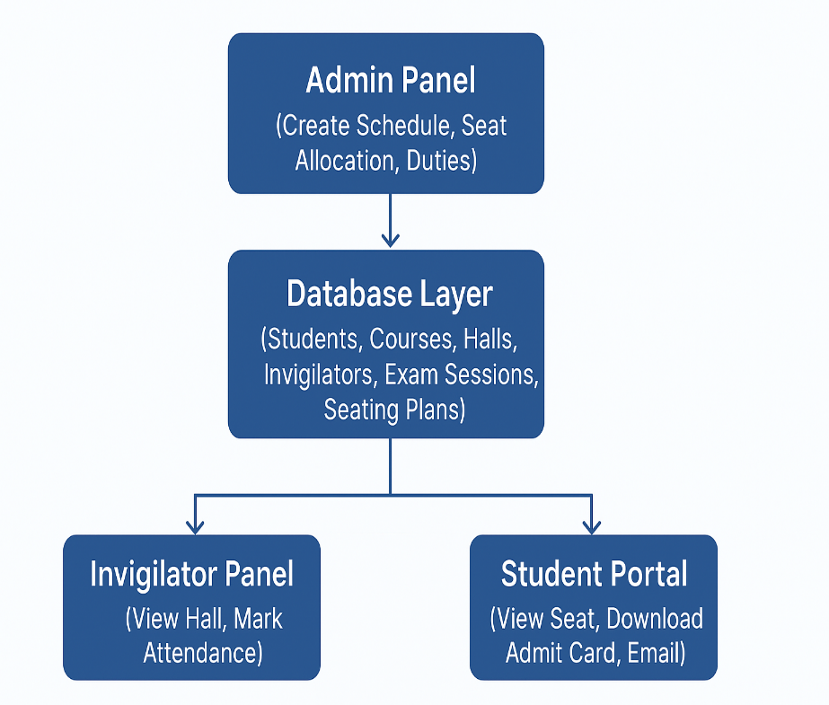
Proposed System
A web application that automates exam scheduling,
seat allocation, and hall management.
Key Features:
Auto seat allocation
Clash detection
Invigilator duty assignment
Admit-card generation
Email notifications for students
Supports Admin, Invigilator, and Student roles.

Slide 5
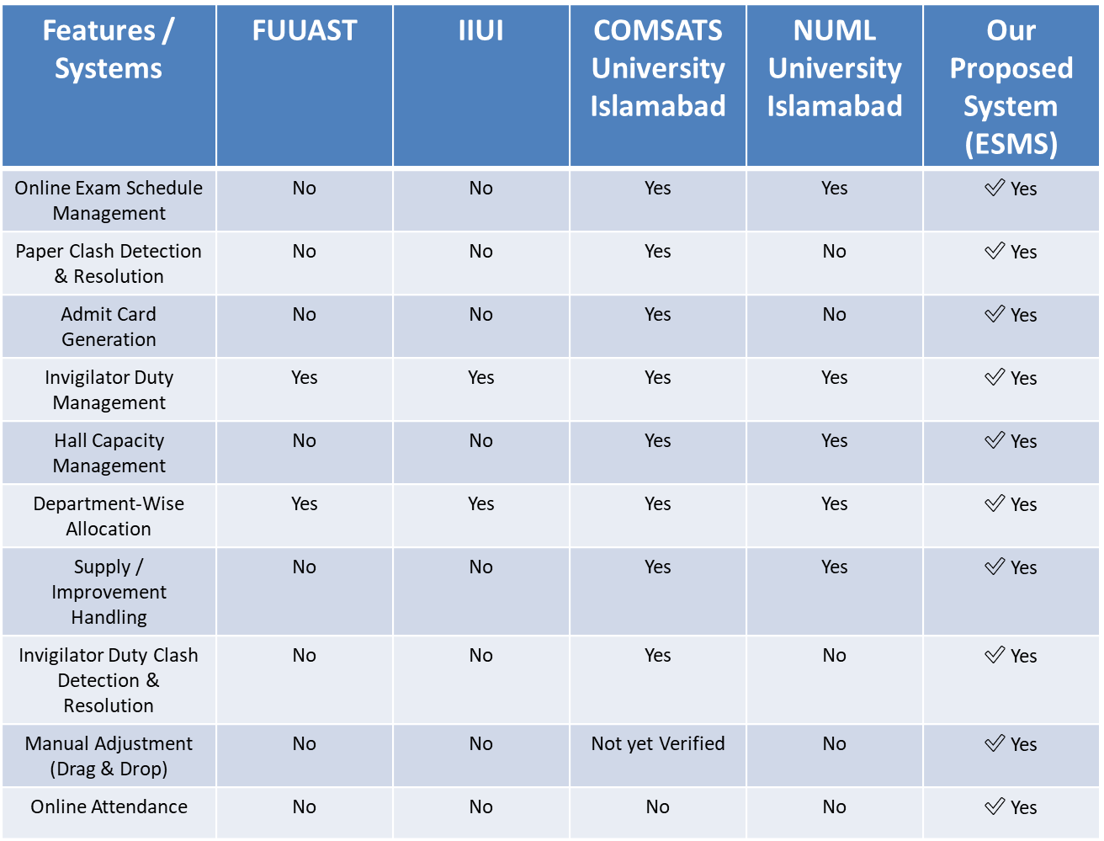
Table 1.1: Survey Analysis

Slide 6
Modules and Sub-Modules
User & Role Management • Admin – Creates exam schedules, seating plans, and manages invigilators • Invigilator – Views assigned halls and marks attendance • Student – Views seat number and exam slip
Course Management • Course Details – Course code, title, semester, teacher • Teacher Mapping – Links each course to a department teacher
Student Information Management • Student Profile – Roll number, name, semester, section • Special Flags – e.g., Improvement, Supply

Slide 7
Modules and Sub-Modules
Date Sheet Management • Create/Edit Sheets • Clash Detection • Department Scheduling • Export/Notify • Seating Integration
Exam Management • Exam Scheduling • Clash Report

Slide 8
Modules and Sub-Modules
Exam Hall & Seating Management • Hall Capacity • Hall Setup
Seating Plan Generation • Auto-Allocation • No Same-Subject Adjacent • Seating Reports

Slide 9
Modules and Sub-Modules
Invigilator Duties Management • Duties Assignment • Conflict Avoidance
• Duties Reports
Exam Slip / Admit Card • Slip Generation • Barcode • Attendance Sheets • Email Alerts

Slide 10
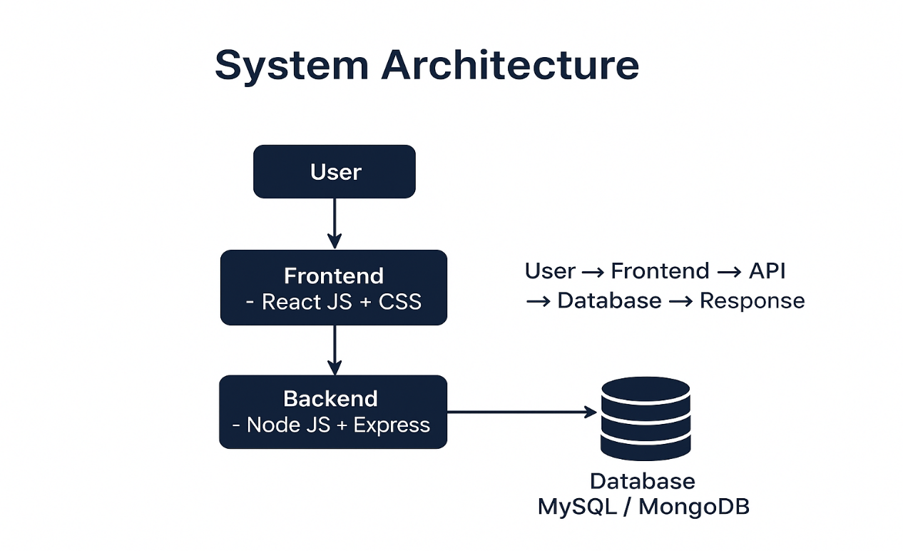
System Architecture
3-Tier Architecture
Frontend: React JS + CSS
Backend: Node JS + Express
Database: MySQL

Slide 11

Primary Actors
Admin / Exam Controller – Creates schedules, seating plans.
Student – Views seat number and downloads exam slip.

Slide 12
Tools and Technologies
Category | Tools
Frontend | React JS, CSS
Backend | Node JS, Express
Database | MySQL
IDE | VS Code
Version Control | GitHub
Deployment | Shared Hosting / Localhost

Slide 13
Process Model and Design Approach
Model Used: RUP (Rational Unified Process)

Slide 14
Any Question Thank You

